Slide 1


Android Lecture #12
Database(SQLite)

Slide 2


Index
Database
Database type
Database Component
Example
Reference

Slide 3
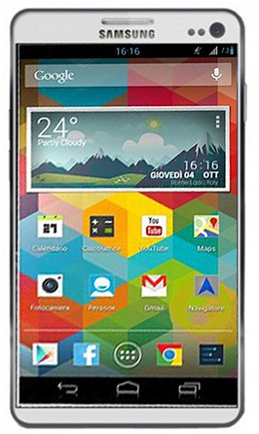
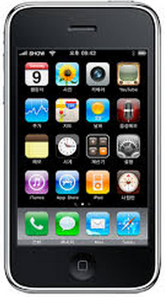

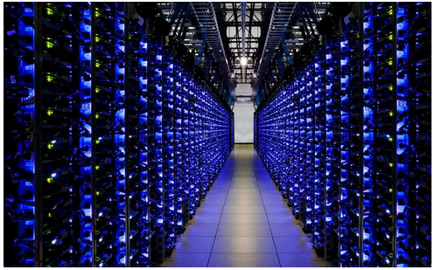
1. Database
Database(DBMS : DataBase Management System)
Store
Manage

Slide 4
2. Database Type
Hierarchical Database
Tree
Hierarchy
Food
Fruit
Meat
Apple
Banana
Tomato
Beef
Pork

Slide 5
2. Database Type
Network Database
Graph Structure
Several Upper Object
Membership
Order
Company
Product

Slide 6
2. Database Type
Relational Database
Stable
Independent
Table1
Table2
Table3
Efficient
Name | Age | Email | Phone
A | 21 | aaaa@aa.aa | 11111111
B | 22 | bbb@bb.bb | 22222222
C | 24 | ffff@ff.ff | 44444444

Slide 7
2. Database Type
Database Program
SQL Server
Access
Oracle Database
DB2
SQLite
Mobile Optimization

Slide 8


3. Database Component
SQLite Database Build
Database Management System Install
Database Build
Use Database by using DMBS
Create Database
Create Table
Input Data
(Add records)

Slide 9

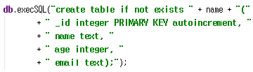
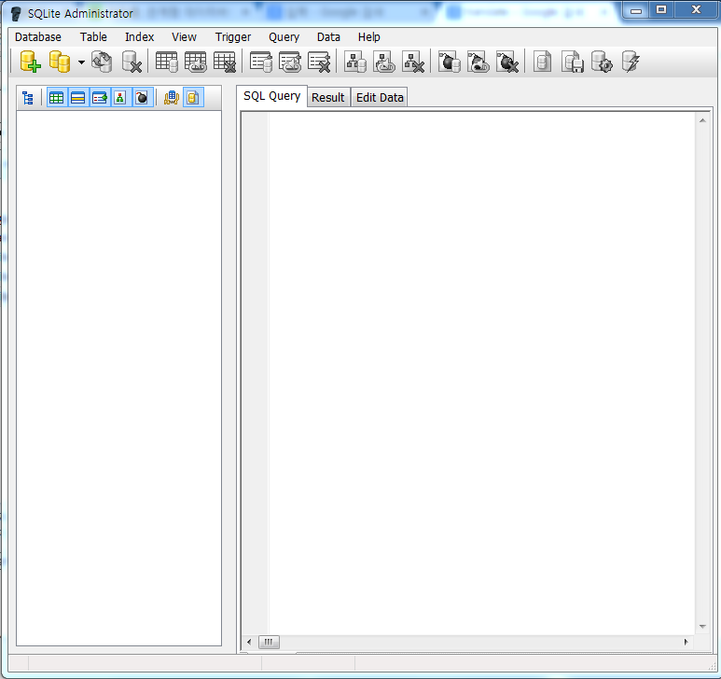
3. Database Component
How to create a database
Code
Database
Table
Program

Slide 10
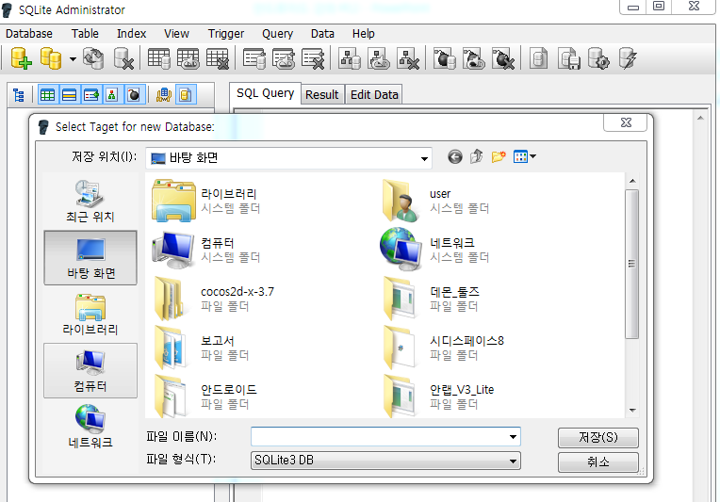
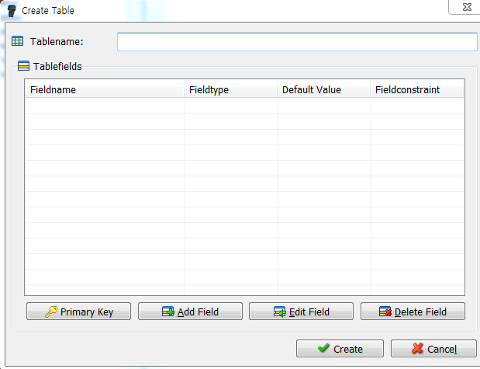
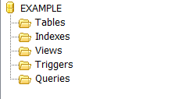
3. Database Component
Database Program (sqliteadmin.exe)
Database -> new
Name -> Save
Table -> new
ID
Field

Slide 11
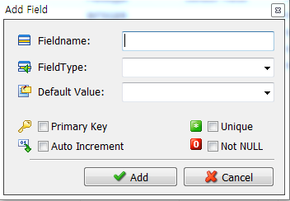
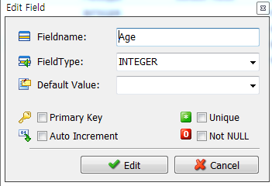
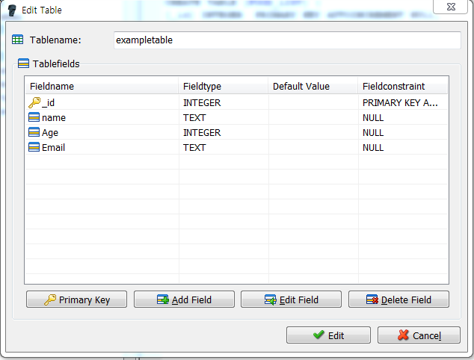
3. Database Component
Database Program (sqliteadmin.exe)
Add Field
Edit Field

Slide 12
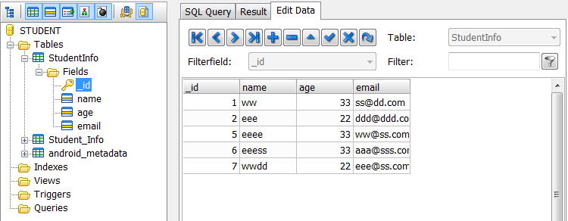
3. Database Component
Database Component
Data
Database
Group of data
Table
Group of field
Field
Index of field
Records
Saved data

Slide 13
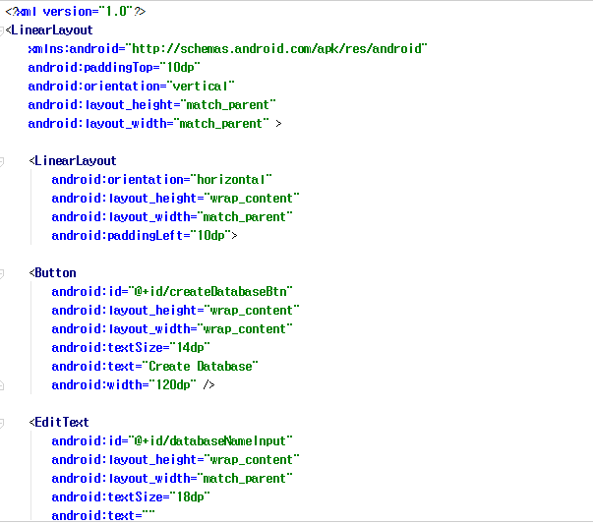
4. Example
Layout (Activity_main.xml)

Slide 14
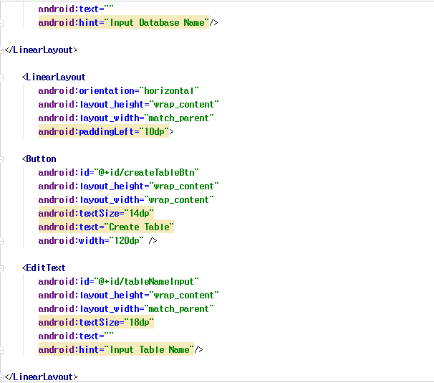
4. Example
Layout (Activity_main.xml)

Slide 15
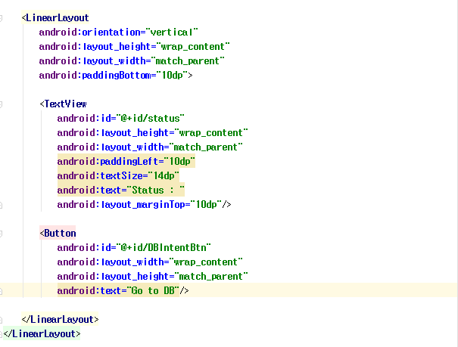
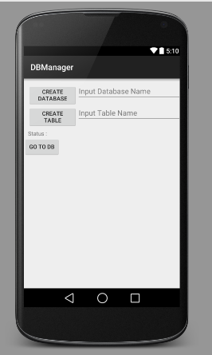
4. Example
Layout (Activity_main.xml)

Slide 16
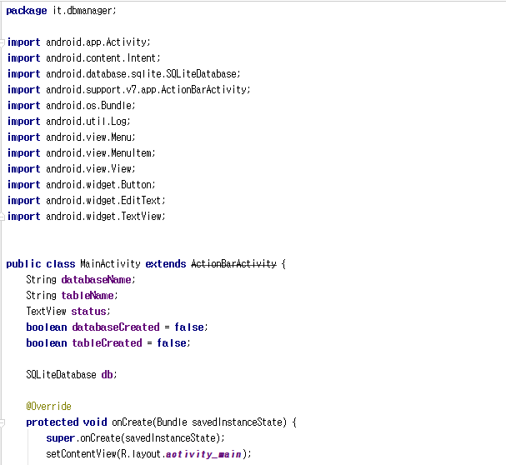
4. Example
Java file(MainActivity.java)

Slide 17
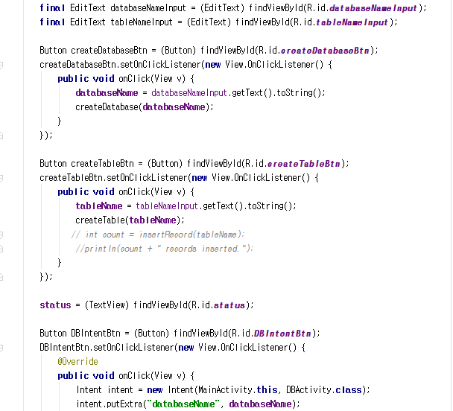
4. Example
Java file(MainActivity.java)

Slide 18
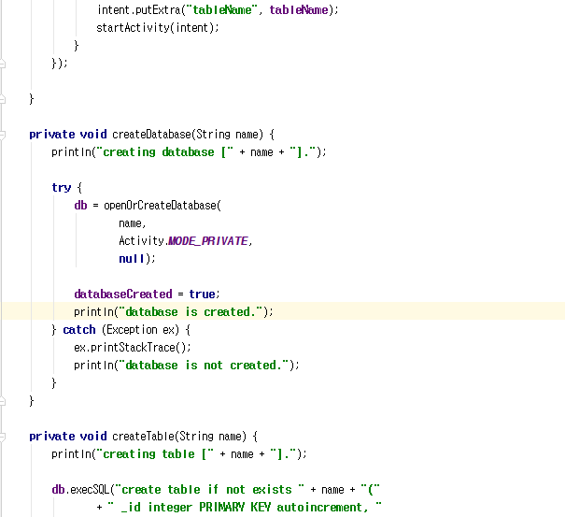
4. Example
Java file(MainActivity.java)

Slide 19
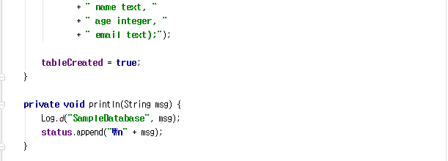
4. Example
Java file(MainActivity.java)

Slide 20
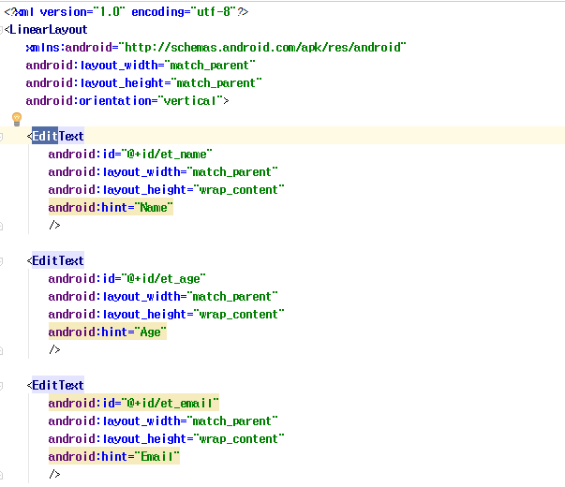
4. Example
Layout (database.xml)

Slide 21
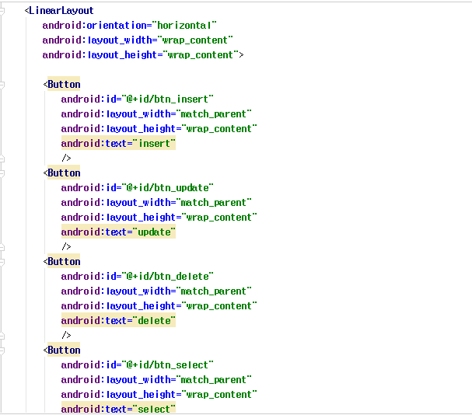
4. Example
Java file(database.xml)

Slide 22
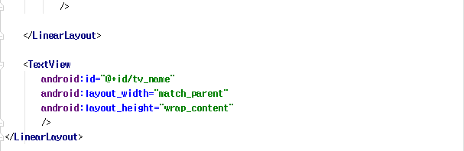
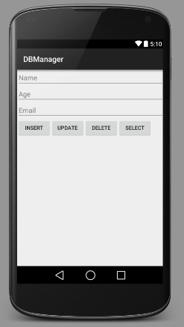
4. Example
Java file(database.xml)

Slide 23
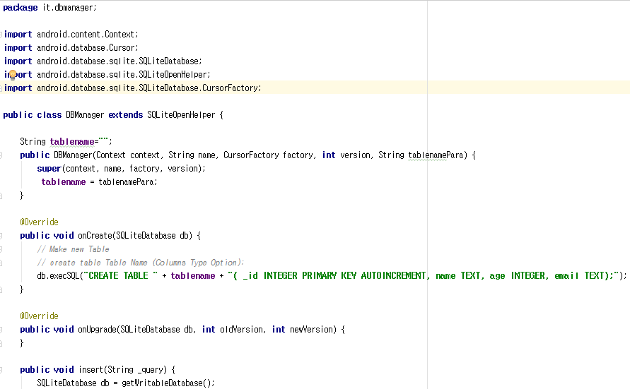
4. Example
Java file(DBManager.java)

Slide 24
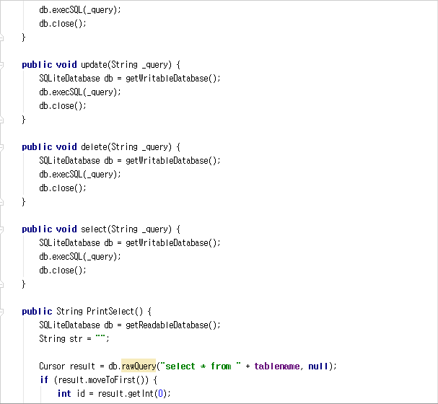
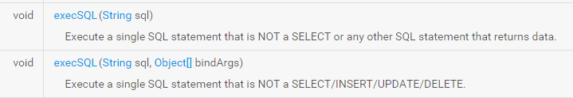
4. Example
Java file(DBManager.java)

Slide 25
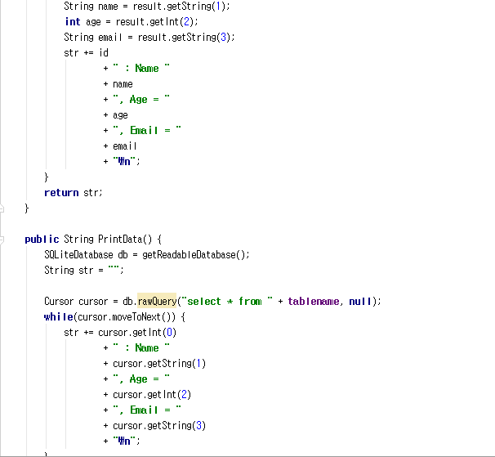
4. Example
Java file(DBManager.java)

Slide 26
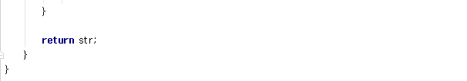
4. Example
Java file(DBManager.java)

Slide 27
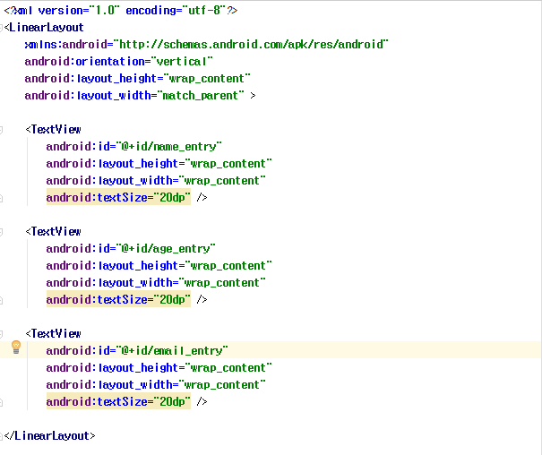
4. Example
Layout (list.xml)

Slide 28
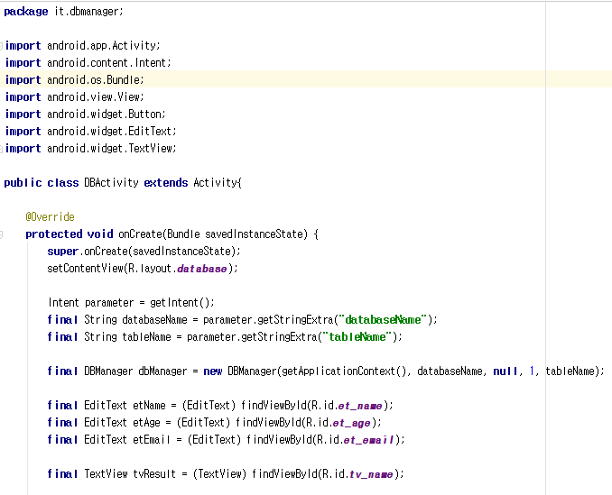
4. Example
Java file(DBActivity.java)

Slide 29
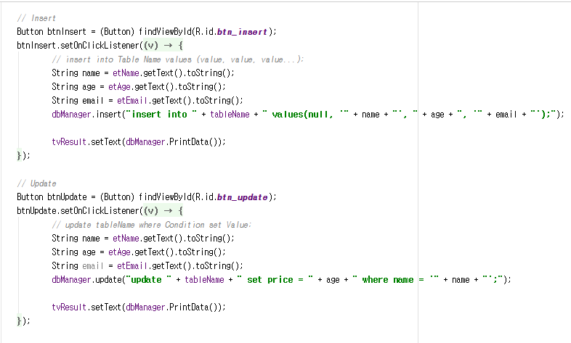
4. Example
Java file(DBActivity.java)

Slide 30
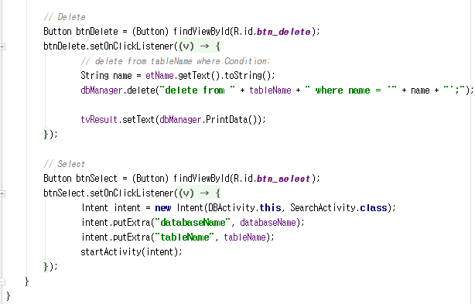
4. Example
Java file(DBActivity.java)

Slide 31
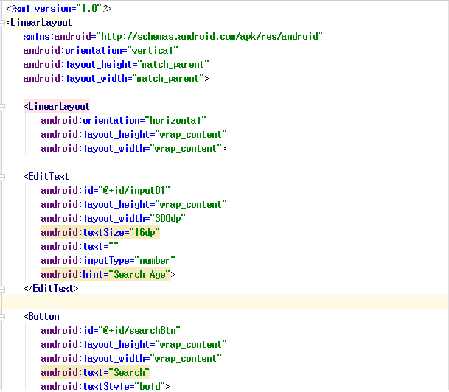
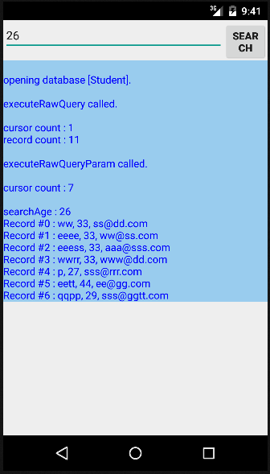
4. Example
Layout (search.xml)

Slide 32
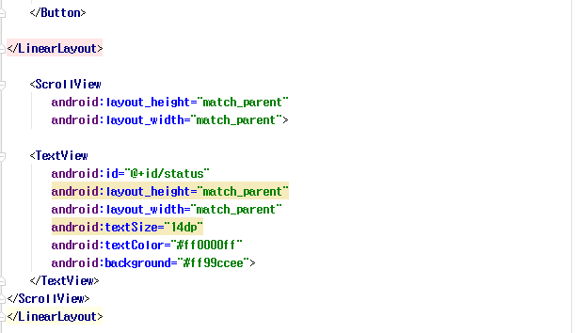
4. Example
Layout (search.xml)

Slide 33
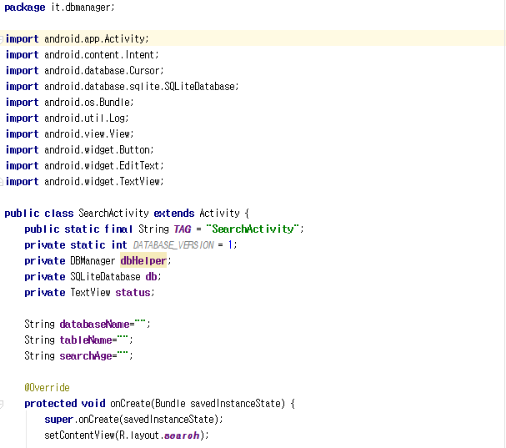
4. Example
Java file(searchActivity.java)

Slide 34
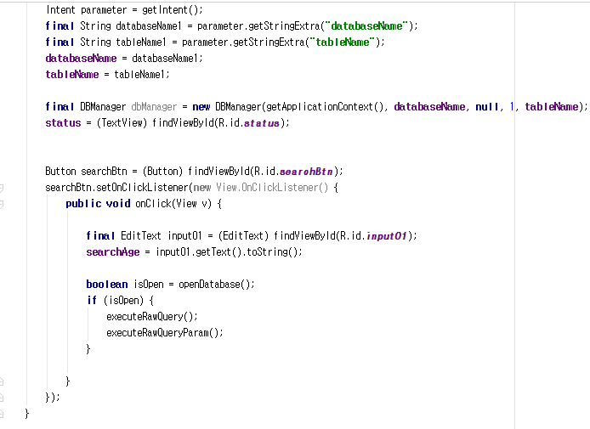
4. Example
Java file(searchActivity.java)

Slide 35
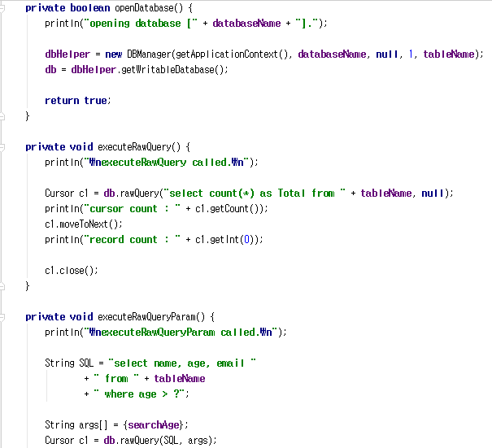
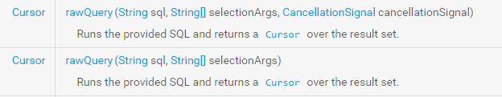
4. Example
Java file(searchActivity.java)

Slide 36
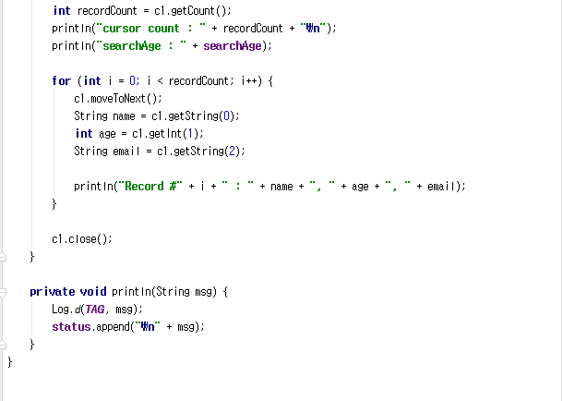
4. Example
Java file(searchActivity.java)

Slide 37
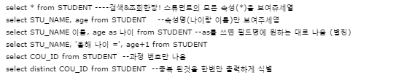
5. Reference
Reference

Slide 38
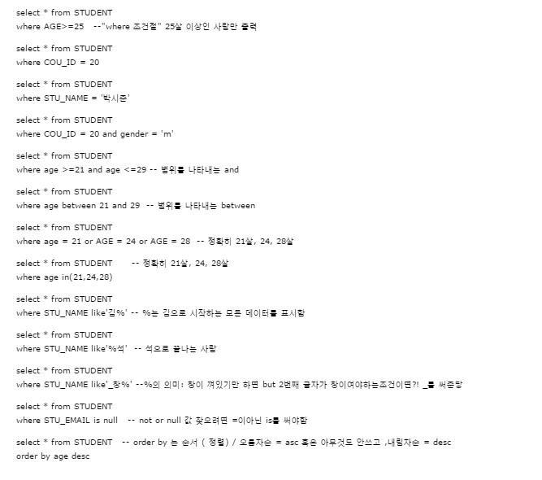
5. Reference
Reference

Slide 39
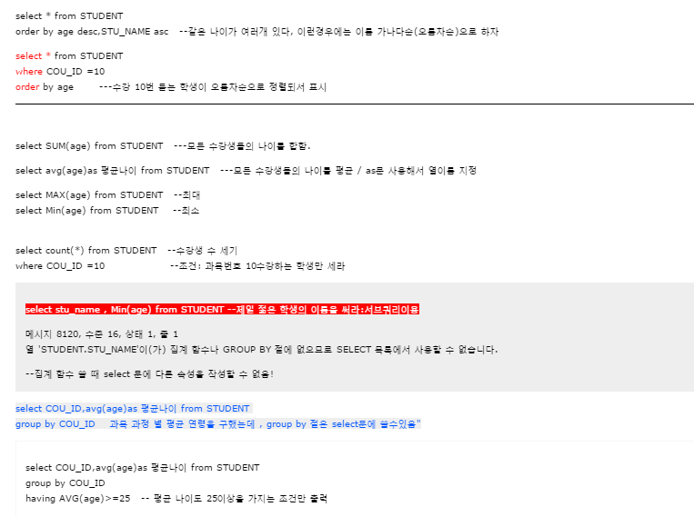
5. Reference
Reference

Slide 40
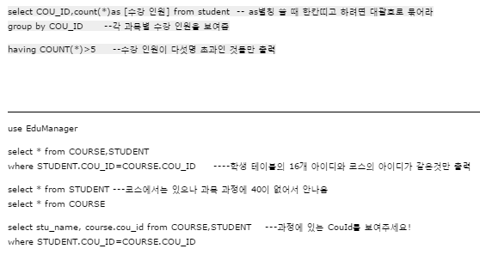
5. Reference
Reference

Slide 41
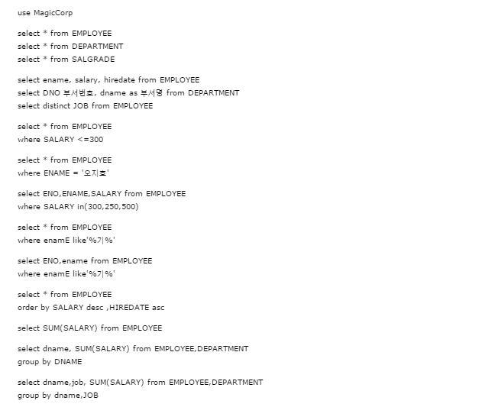
5. Reference
Reference

Slide 42
Thank you!

